Slide 1

Predicting Solar Energy Production
Data-Driven Insights for Smarter Project Planning
-By Nidhi Patel

Slide 2
Problem Statement
Solar developers and investors need accurate estimates of annual energy production before project implementation.
Current estimates are manually derived and error-prone.
Objective:
Develop a machine learning model to predict energy production based on project features like location, developer, equipment, and system size.

Slide 3
Business Objective
📈 Optimize Project Planning: Forecast energy yield to evaluate financial feasibility.
💡 Empower Customers: Help choose optimal location, developer, and equipment.
⚡ Support Grid Integration: Estimate solar output to stabilize load planning.
📊 Enable Data-Driven Decisions: Back decisions with insights, not assumption.

Slide 4
Workflow
Data Collection
Data Cleaning & preprocessing
Exploratory Data Analysis
Feature Engineering
Model Development
Model Evaluation
Insights & Results

Slide 5
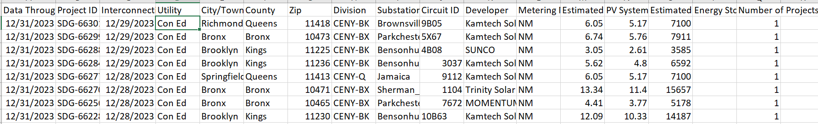
Data Overview
Dataset Name: Predicting Solar Energy Production- Data(Historic)
Total Records: 218,115 solar projects
Features: Project ID, Location (ZIP, County), Developer, System Size, Metering Type, Interconnection Date, etc.
Target Variable: Estimated Annual PV Energy Production (kWh).

Slide 6
Data Source
Data Through Date | The date up to which the data in the dataset is valid or relevant.
Project ID | A unique identifier for each solar power project in the dataset.
Interconnection Date | The date when the solar power project was connected to the grid or power distribution system.
Utility | The utility company or organization responsible for managing the power grid and distributing electricity.
City/Town | The location of the solar power project (city or town).
County | The administrative division within the state where the solar project is situated.
Zip | The postal code or ZIP code corresponding to the project’s location.
Division | A further geographical subdivision within the state (if applicable).
Substation | The electrical substation where the solar power project is connected to the grid.
Circuit ID | The unique identifier for the circuit within the substation that the solar project is connected to.
Developer | The entity or organization responsible for developing and implementing the solar power project.
Metering Method | The method used to measure and record the solar energy production (e.g., net metering, gross metering).
Estimated PV System Size (kWdc) | The estimated size of the photovoltaic (PV) system in kilowatts direct current (kWdc). This represents the total capacity of the solar panels.
PV System Size (kWac) | The actual size of the PV system in kilowatts alternating current (kWac). This accounts for system losses and efficiency.
Estimated Annual PV Energy Production (kWh) | The projected annual energy production from the PV system in kilowatt-hours (kWh). This estimate considers factors like solar irradiance, panel orientation, and efficiency.
Energy Storage System Size (kWac) | If applicable, the size of any energy storage system (such as batteries) connected to the solar project, measured in kilowatts alternating current (kWac).
Number of Projects | The total count of solar power projects represented in the dataset.

Slide 7
Data Cleaning & Preprocessing
Dropped columns with excessive missing values (e.g., Division, Substation).
Handled categorical variables using Label Encoding (e.g., Developer, City/Town).
Created new features like System Efficiency and Interconnection Year.
Removed outliers in production, system size, and ZIP codes.

Slide 8
Exploratory Data Analysis
Strong correlation found between system size (kWdc) and energy output
Certain developers and cities consistently show higher production
Outliers were mostly large-scale commercial solar farms:

Slide 9
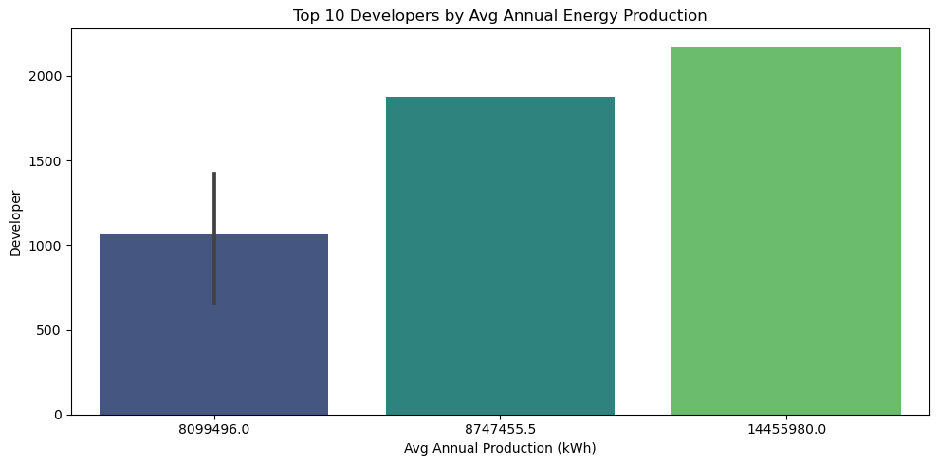
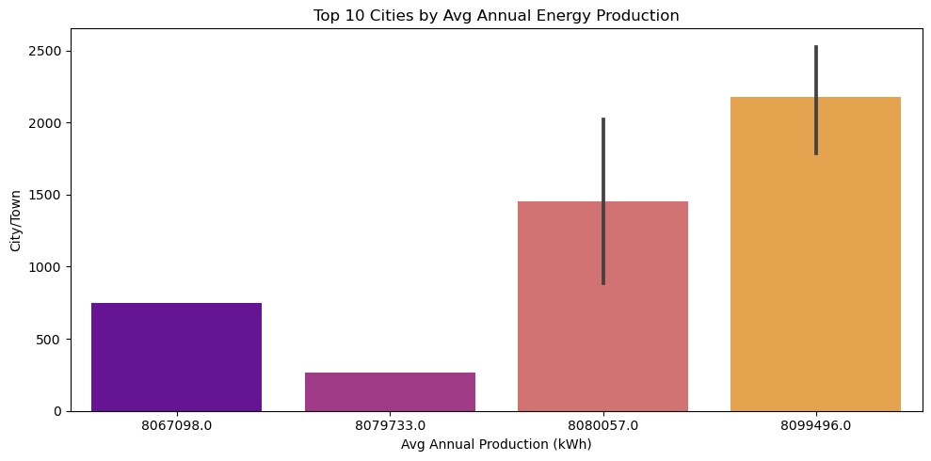
Exploratory Data Analysis

Slide 10
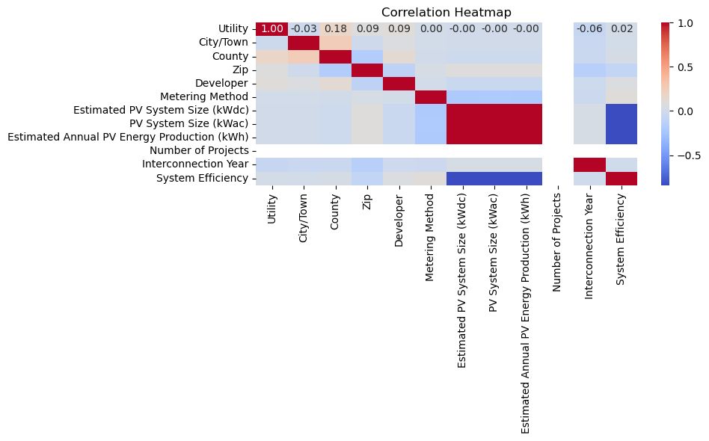
Exploratory Data Analysis

Slide 11
Exploratory Data Analysis
“Certain developers like Kamtech Solar Solutions and Sunrun Inc consistently show high average production.”
“Cities like Queens, Brooklyn, and Bronx dominate in production volume.”
“Strong correlation observed between system size and production (shown in the heatmap).”
“Outliers removed from system size and ZIP to stabilize distributions.”

Slide 12
Modeling Approach
Model 1: With System Size (kWdc, kWac, Efficiency)
Model 2: Without System Size to test for data leakage and generalization
Algorithm used: Random Forest Regressor
Evaluation Metrics: MAE, RMSE, R²

Slide 13
Model Performance Comparison
Model Version | MAE (kWh) | RMSE (kWh) | R² Score
With System Size | 25.30 | 1058.65 | 1.000
Without System Size | 14,966.62 | 164,027.33 | 0.736
Final Model Used: Without leakage-prone features (R² = 0.73)
Final Chosen Model: Without size features
MAE ≈ 14,966 kWh
RMSE ≈ 164,027 kWh
R² ≈ 0.736
This means the model can explain about 73.6% of the variation in annual solar energy production using just location, developer, utility, and project metadata.

Slide 14
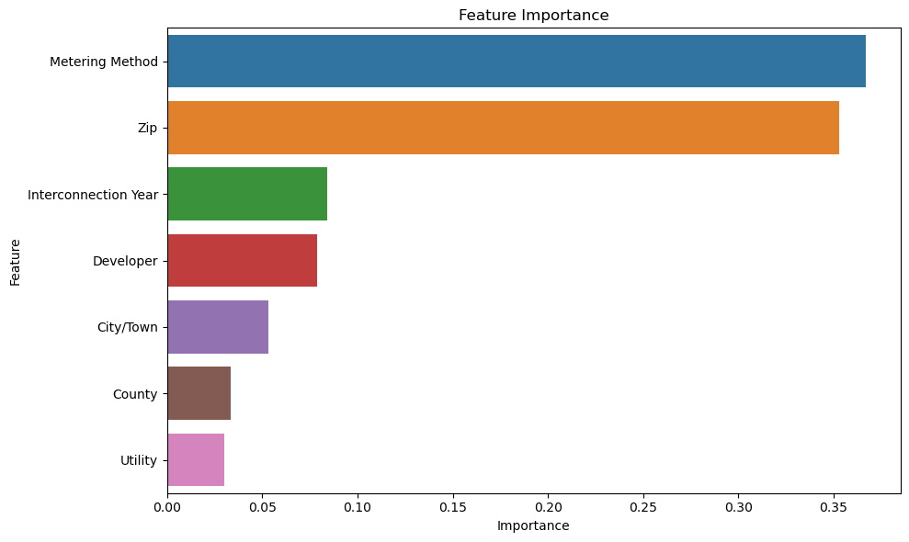
Feature Importance (Final Model)
Top factors influencing energy production:
Developer
County
City
Metering Method
Interconnection Year

Slide 15
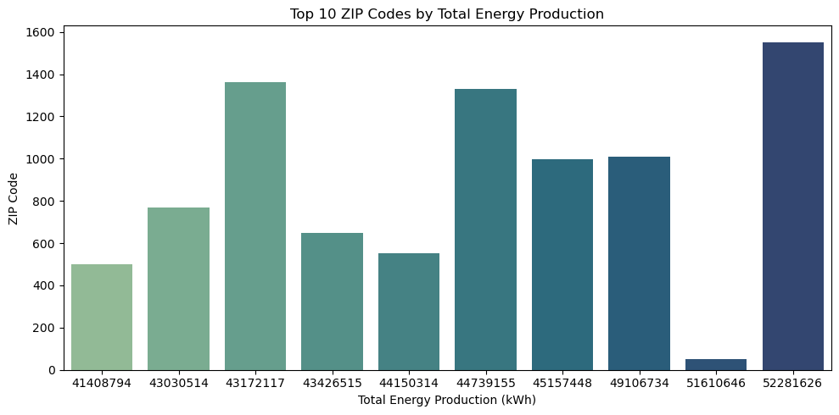
1. Energy Production by ZIP Code (Top 10)

Slide 16
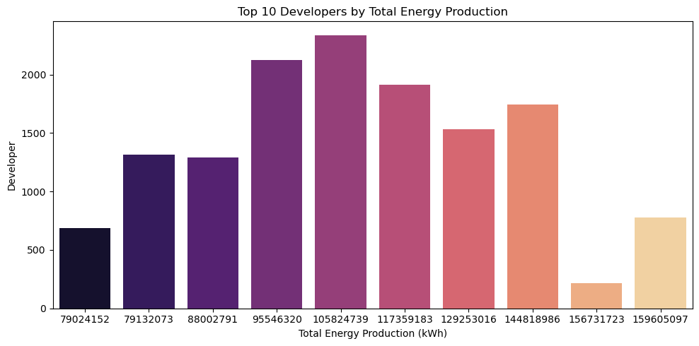
2. Developer-wise Total Energy Production

Slide 17
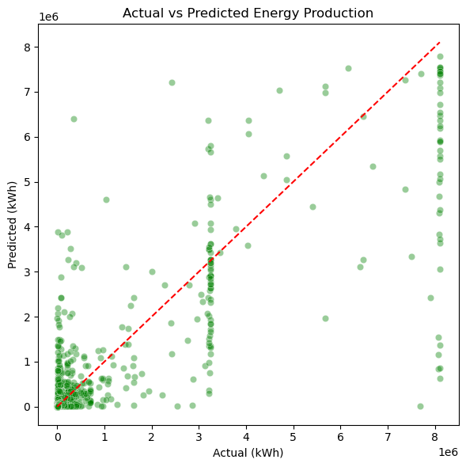
3. Actual vs Predicted Energy (From Final Model)

Slide 18
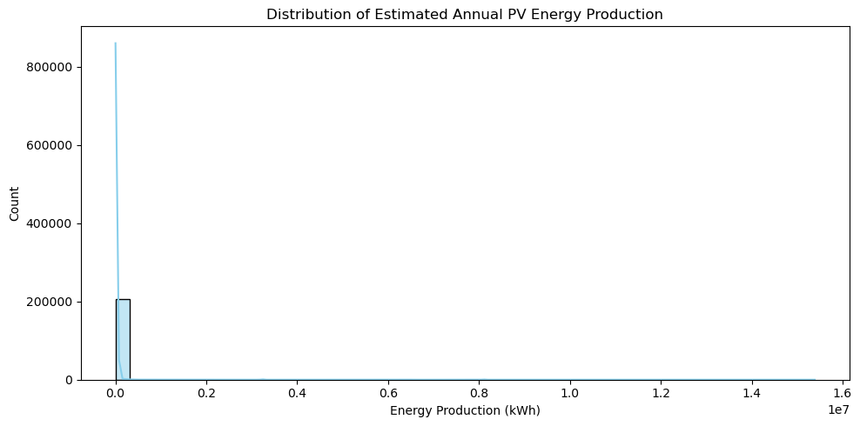
4. Distribution of Energy Production

Slide 19
Model Prediction
Estimated Annual PV Energy Production (in kilowatt-hours) for a solar installation before it’s built or connected to the grid, based on details like:
Location (City, County, ZIP)
Developer
Utility
Metering Method
Interconnection Year
It did not rely on direct system size inputs (kWdc, kWac) in the final model — making it a generalizable, unbiased estimator.

Slide 20
Recommendations & Future Work
Integrate weather/solar irradiance data for better predictions
Include equipment specs like panel type, tilt angle
Explore geospatial clustering for high-yield regions
Deploy model in planning tools or web dashboards

Slide 21
Conclusion
Our ML model enables reliable predictions of solar project output
R² = 0.73 confirms a realistic and generalizable performance
Supports better location, developer, and equipment selection
Improves financial forecasting and grid planning

Slide 22
Thank You

